Slide 1
Donation Portal
By: Keheira H

Slide 2
Team Intro - Keheira
Pronounce: Key-air-uh
Devops engineer
Mobile developer background

Slide 3
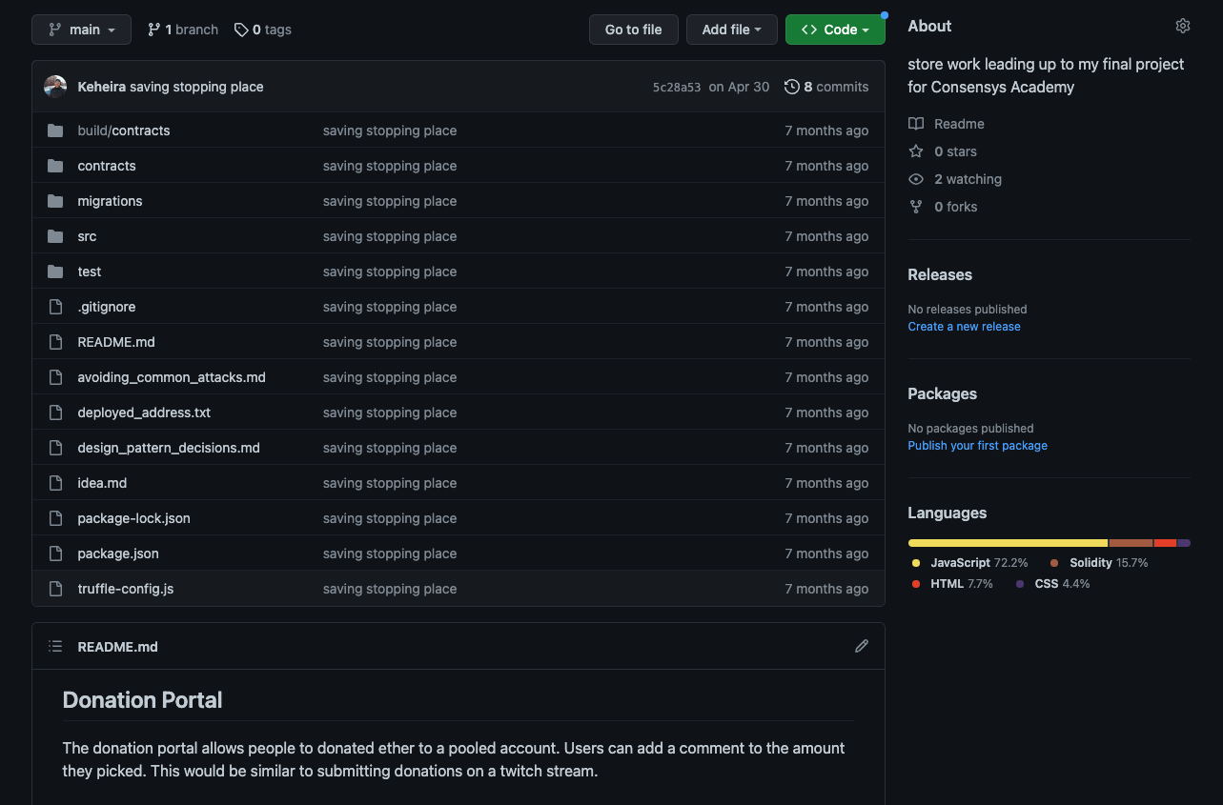
Problem Description
I started this idea months ago but didn’t finish
Initial code here but want to actually complete the idea

Slide 4
Tech Overview
Hardhat
React 🤮
Replit
Solidity
Alchemy
Caffeine

Slide 5
Solution Description
Main actions:
Add donation
Get top donation
Get total donation amount
Withdraw donations from contract (as owner)
Reset public donation info (as owner)
What I’d add later:
Check for owner and show withdrawal and reset button
Tie in with livepeer?

Slide 6
Demo
Code: https://github.com/Keheira/Twitch-Donations
Test: pending
Untested UI: https://donation-portal.keheira.repl.co

